Slide 1
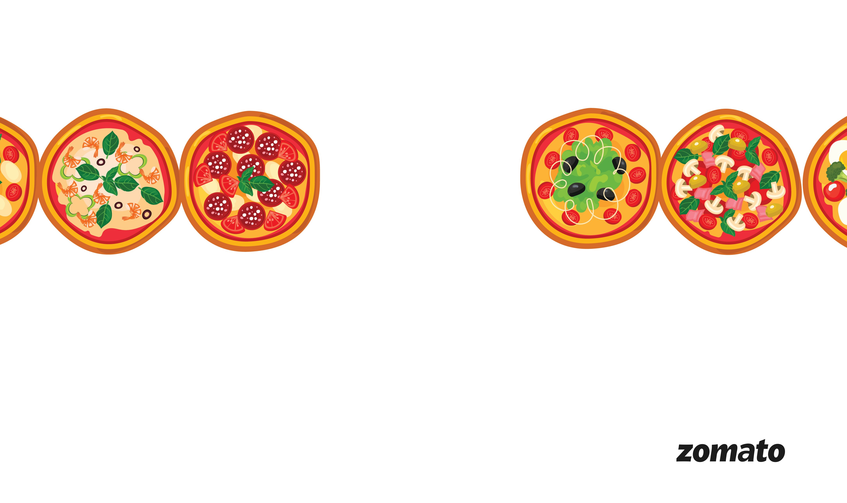
Zomato Data Analysis
Exploring Restaurant Trends Across Countries and Cities
Group Members:
Simanchala Sahu
Mahesh Manik Bantu
Yashvit Jain
Lokesh Mahesh Patil
Rishi Madhavi
Ananta Dhuraji Mhaske
Objectives:
To analyze restaurant data from Zomato to uncover key insights into global dining patterns, customer ratings, cuisine popularity, and market presence across countries and cities.
Key Focus Areas:
Country-wise and city-wise restaurant distribution
Popular cuisines and average ratings
Pricing trends and online delivery availability
Top-performing and underperforming regions

Slide 2
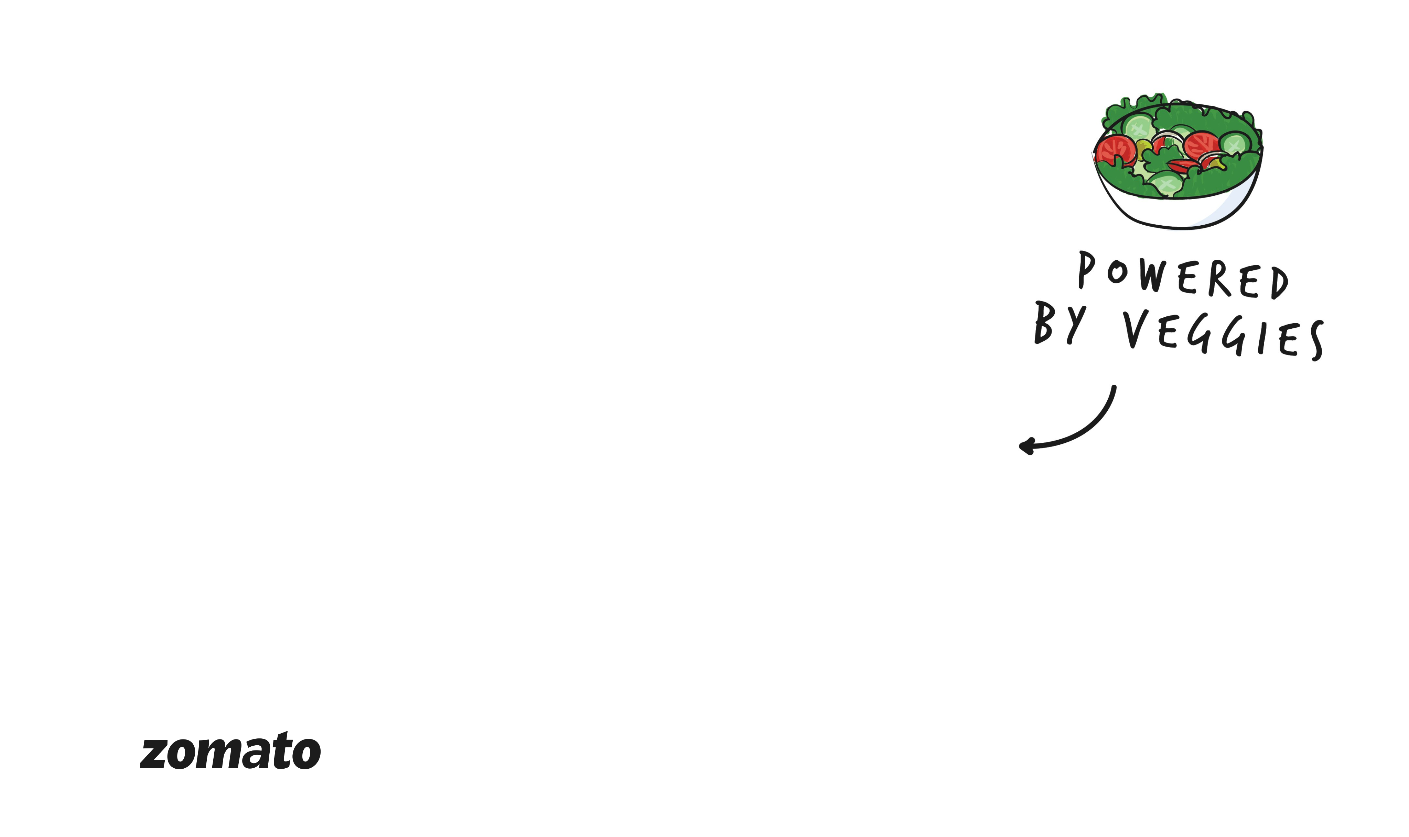
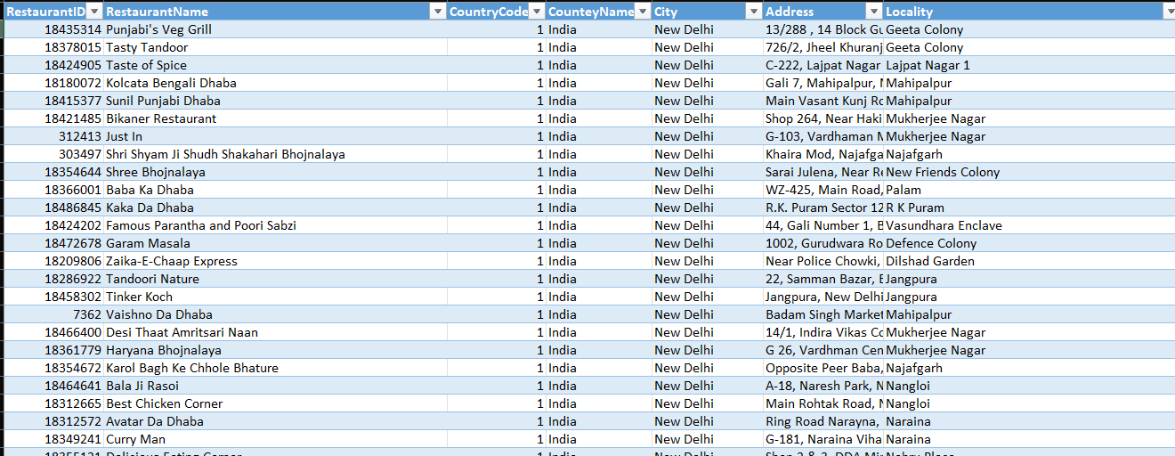
The Data Set
Data Insight:
This Zomato dataset contains detailed information about restaurants, particularly focusing on their location, cuisine, locality, and operational data.
Each record includes attributes such as restaurant name, address, city, locality, coordinates, and opening dates, alongside time-based fields like weekday, month, and financial quarter.
It's ideal for analyzing restaurant trends over time and across regions.

Slide 3
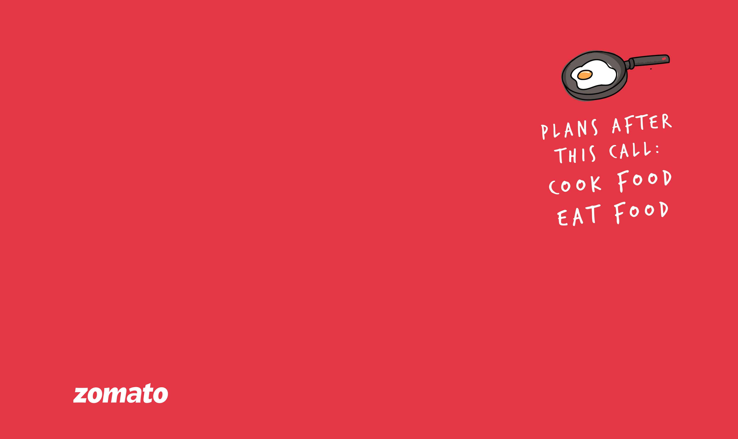
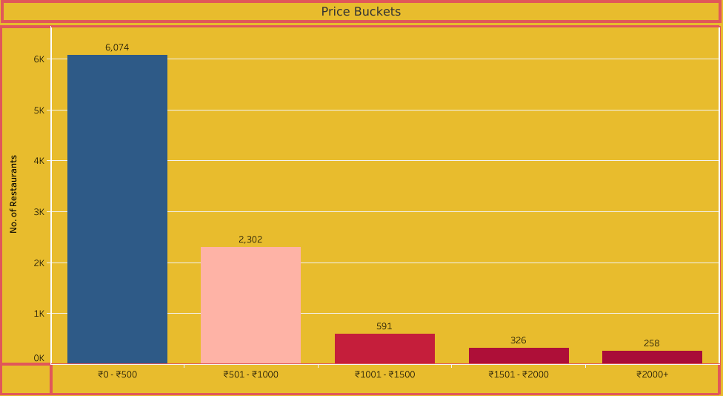
Price Buckets
Most restaurants fall under budget-friendly segment:
₹ 0–₹500: 6,074 restaurants
₹ 501–₹1000: 2,302
Higher price ranges (₹1000+) have significantly fewer listings.
Chart dynamically updates by country and year selection.

Slide 4
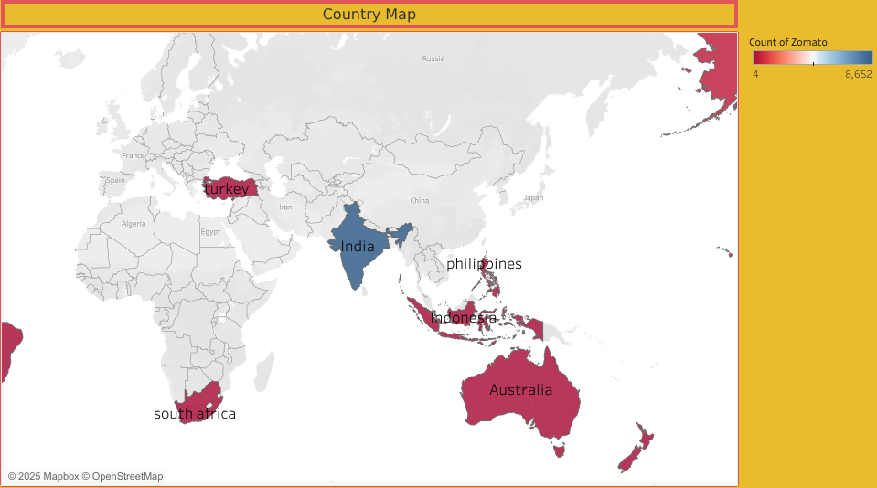
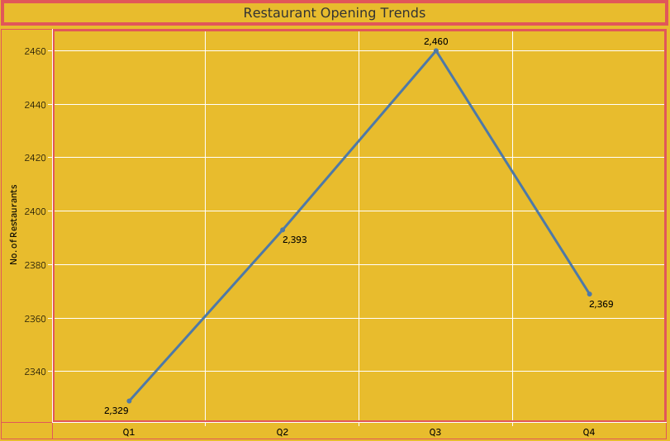

Country Map
Map Insight:
This heat map visualizes the geographic distribution of Zomato-listed restaurants across several countries.
India stands out with the highest count of restaurants listed (~8,652), shown in dark blue.
Other countries like Australia, South Africa, Turkey, and Indonesia show moderate coverage.
Philippines and a few other Southeast Asian countries are also visible with lighter red tones, indicating fewer listings.
Restaurant Opening Trends
📊 Insights – Restaurant Opening Trends:
Growth from Q1 to Q3, peaking at 2,460 in Q3.
Slight dip in Q4 (to 2,369), possibly due to seasonal or budget factors.
Overall trend shows stable and consistent growth throughout the year.

Slide 5
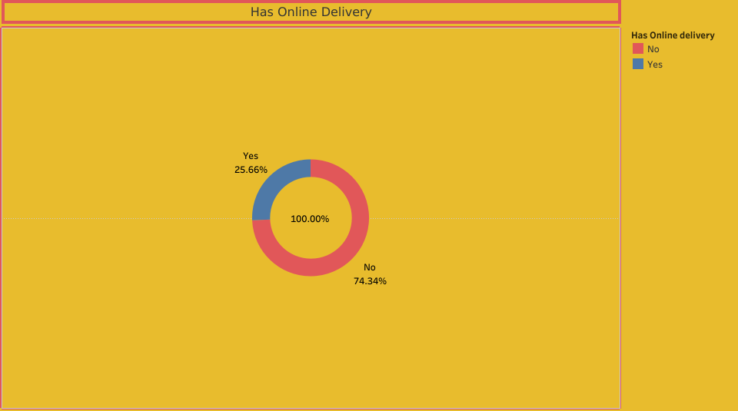
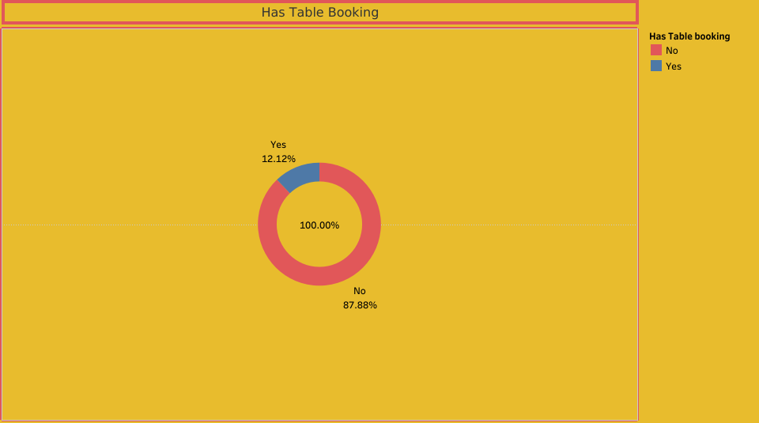

Insights:
Shows the percentage of restaurants that offer online delivery.
Two segments:
Yes (25.66%) – Blue section: restaurants with online delivery.
No (74.34%) – Red section: restaurants without it.
More restaurants offer online delivery than table booking, but still not the majority.
Has Online Delivery
Insights:
This Donut Chart shows the percentage of restaurants that do or do not offer table booking.
Two segments:
Yes (12.12%) – Blue section: restaurants that offer table booking.
No (87.88%) – Red section: restaurants that do not.
Only a small portion of restaurants allow table booking. It’s a less common service.
Has Table Booking

Slide 6
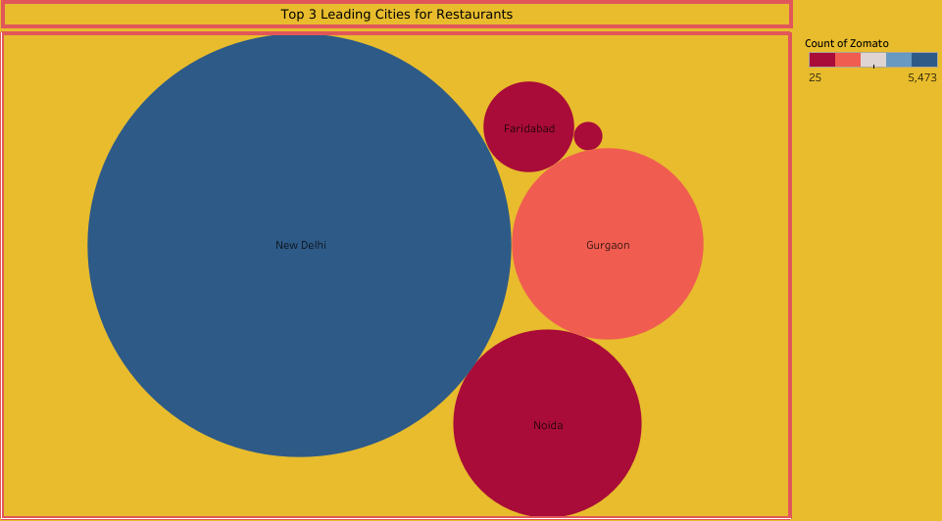
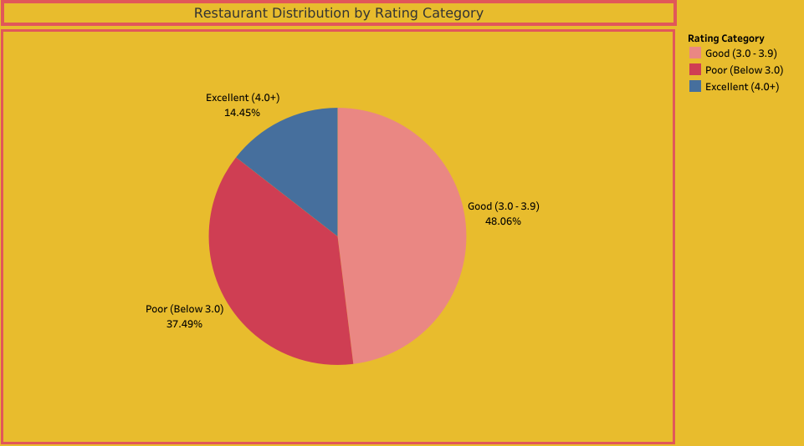
Top 3 Leading Cities for Restaurants
Restaurant Distribution by Rating Category
Insights:
City rankings update by selected country, showing Zomato’s strongest urban markets per region.
In the current view, New Delhi leads, followed by Gurgaon and Noida — highlighting India's NCR as a restaurant Hotspot.
Smaller cities like Faridabad and others appear with lesser counts, showing a concentrated presence in metros.
Insights:
This pie chart shows % of restaurants by rating: Excellent (4.0+), Good (3.0–3.9), Poor (<3.0)
Chart updates based on selected country and year.
Current view shows:
48% rated Good
37% rated Poor
Only 14% rated Excellent

Slide 7

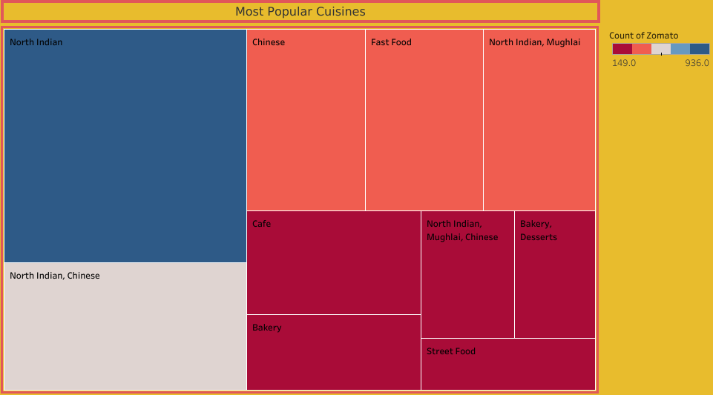
Most Popular Cuisines
Insights:
This chart shows cuisines organized by popularity, often grouped by category or type.
The size of each box or level reflects how often a cuisine appears in the dataset.
Indian, Chinese, and Fast Food cuisines are the most dominant overall. The chart shows that local tastes drive popularity, but international options like Italian and Continental are also widely available.

Slide 8

Key Takeaways – Zomato Restaurant Insights.🧾
India leads the pack with the highest number of restaurants—Zomato ka asli adda!
New Delhi steals the limelight, boasting the highest concentration of eateries.
Q3 is the hot favourite for restaurant openings for food business!
Majority of restaurants are budget-friendly (₹0–₹500)
Good ratings (3.0–3.9) dominate, but there’s room for improvement—aim for more Excellent (4.0+) scores.
City, rating, and pricing insights are dynamic—change with country/year filters.
Table Booking is rare — only 12.12% of restaurants offer it. Most places serve walk-in customers.
Online Delivery is more common, with 25.66% of restaurants providing the service.
Top Cuisines include North Indian, Chinese, and Fast Food, showing a mix of local and global preferences.
The hierarchy chart gives a structured view of cuisine popularity, helping identify main and sub-categories.
So, it’s all about data pe nazar, customer pe asar.

Slide 9

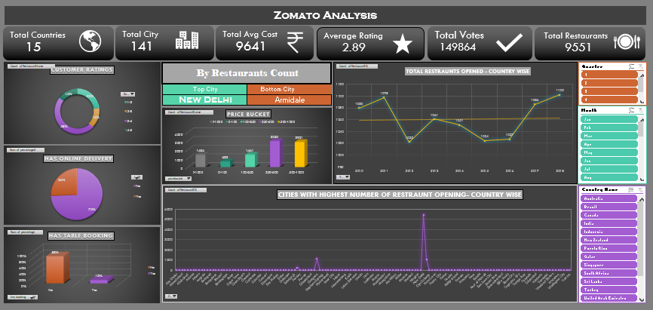
Excel Dashboard

Slide 10

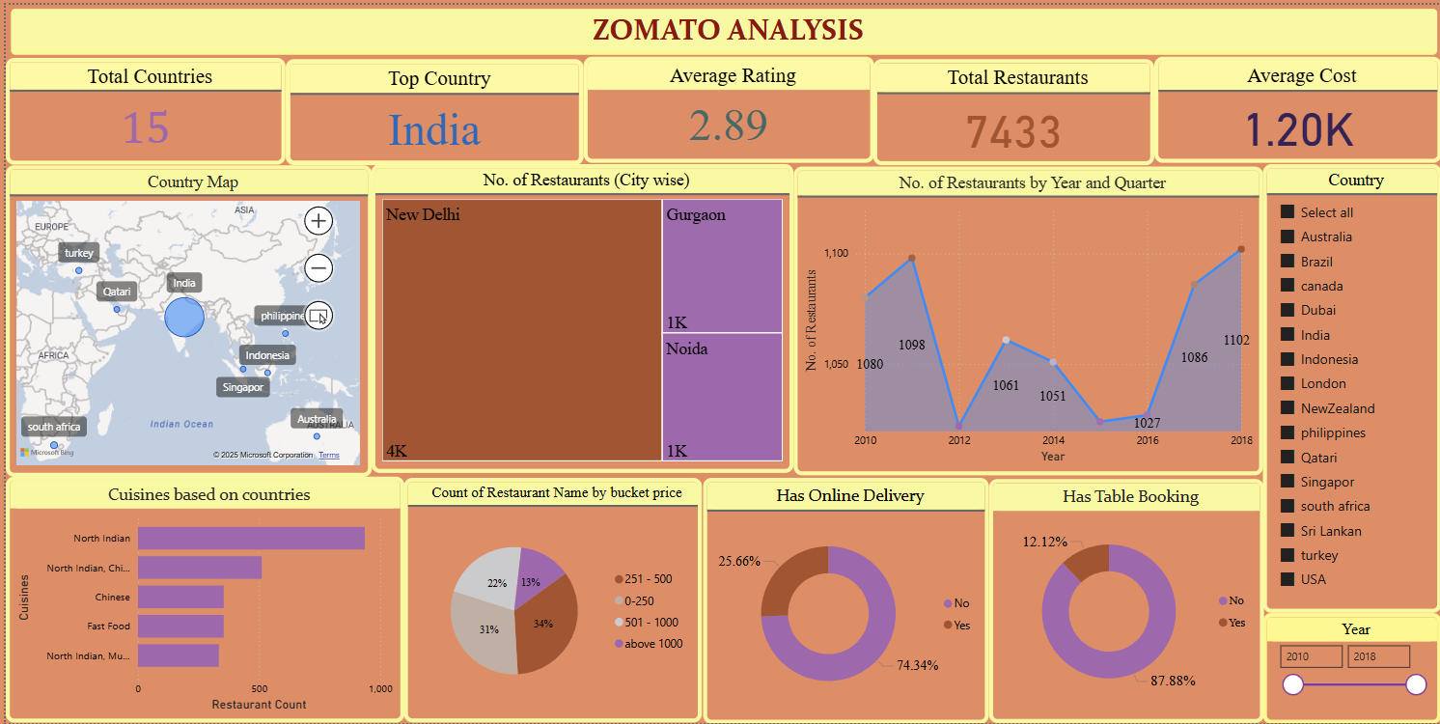
Power-BI Dashboard

Slide 11

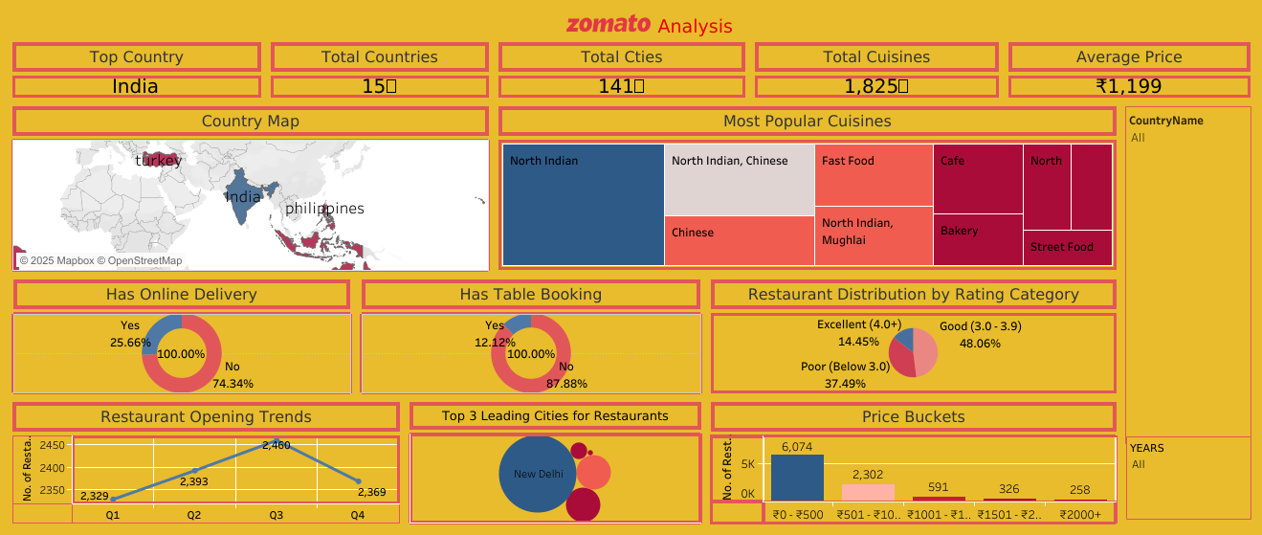
Tableau Dashboard

Slide 12

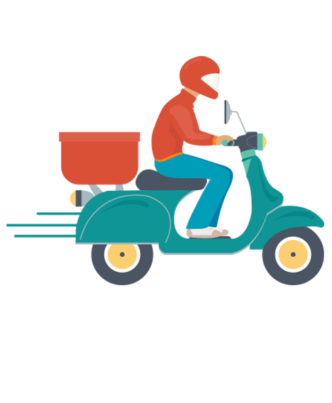
THANK YOU!

